Slide 1

FUNDRAISING AND CHARITY PLATFORM WITH MORE ACCURACY AND TRANSPARENCY
Govind Sawarn (RA1911003030290)
Guide Name: Dr. Dheeraj Tandon
CSE-I May 2023

Slide 2
TABLE OF CONTENTS
ABSTRACT
INTRODUCTION
LITERATURE SURVEY
TESTING
RESULT
SYSTEM ARCHITECTURE
RESULT
CONCLUSION
FUTURE ENHANCEMENT
REFERENCES

Slide 3
ABSTRACT
A fundraising charity platform is a digital platform that provides a means for individuals and organizations to raise funds for charitable causes or social initiatives. The platform typically allows donors to browse through various fundraising campaigns and select the ones they wish to support. Donors can securely donate funds online, and the platform provides tools to track the impact of their contributions.
Campaign creators can manage their campaigns through the platform and communicate with donors. Additionally, the platform may provide tools to promote campaigns through social media and other channels.
The ultimate goal of a fundraising charity platform is to facilitate fundraising and support for a range of charitable causes and social initiatives. These may include disaster relief, medical research, education, environmental conservation, and many other causes. By providing a digital platform for fundraising, these platforms aim to make charitable giving more accessible, efficient, and transparent for everyone involved.

Slide 4
INTRODUCTION
A fundraising and charity platform serves as a transformative digital solution that revolutionizes the way
individuals and organizations raise funds for charitable causes and social initiatives. With an emphasis
on accuracy and transparency, these platforms have emerged as powerful tools that bridge the gap between donors and beneficiaries, making the process of giving more efficient and accountable.
In the traditional fundraising landscape, transparency and accuracy were often lacking, leaving donors uncertain about where their contributions were being utilized and whether they were making a genuine impact. However, fundraising and charity platforms have addressed these concerns by incorporating robust features that ensure a higher level of accuracy and transparency.
One key aspect is the ability for donors to browse through a wide range of fundraising campaigns on the platform. Each campaign provides detailed information about the cause, the organization behind it, and how the funds will be utilized. This empowers donors to make well-informed decisions based on their personal values and interests.
Furthermore, these platforms offer secure and streamlined online donation mechanisms. Donors can contribute funds using various payment options, and the platforms utilize advanced encryption technologies to safeguard sensitive information. This ensures that donations reach the intended recipients securely
and efficiently. To enhance transparency, fundraising and charity platforms provide real-time tracking tools that enable donors to monitor the impact of their contributions.

Slide 5
LITERATURE REVIEW
SL.NO | Title | Merits | Demerits
1 | A secure fundraising framework based on a distributed ledger system | Achieving enhanced transparency and security, while empowering stakeholders. | no specific disadvantages mentioned.
2 | Developing a dependable charity donation service system amidst the Covid- 19 pandemic | Enhancing efficiency, promoting transparency, and minimizing fraud and corruption. | no specific disadvantages mentioned.

Slide 6
LITERATURE REVIEW
SL.NO | Title | Merits | Demerits
3 | A blockchain-based logistics platform for public philanthropy. | The model aims to maximize social welfare by enhancing trust, cleanliness coefficient, and material quality. | No any disadvantages mentioned
4 | A blockchain-based platform for tracking donations in charitable foundations. | Increased transparency, improved accountability and trustworthiness. | No specific disadvantages mentioned.

Slide 7
LITERATURE REVIEW
SL.NO | Title | Merits | Demerits
5 | A blockchain-based charity supervision and management system. | Ensuring higher security, autonomy, reliability, trustworthiness, and credibility for charity projects | No specific disadvantages mentioned.
6 | Utilizing blockchain technology to enhance transparency, accountability, and efficiency in charitable organizations. | Achieving enhanced security, efficiency, and cost-effectiveness simultaneously | No specific disadvantages mentioned.

Slide 8
LITERATURE REVIEW
SL.NO | Title | Merits | Demerits
7 | blockchain technology in smart grid systems. | Enhancing security, privacy, efficiency, and cost-effectiveness while maintaining originality. | No specific disadvantages mentioned
8 | a blockchain-based charity foundation platform Called karma | The Karma-Token project proposes a blockchain-based charity foundation platform that enhances transparency, trustworthiness, and prevents fraudulent behavior. | No specific disadvantages mentioned

Slide 9
LITERATURE REVIEW
SL.NO | Title | Merits | Demerits
9 | NFT-Based Fundraising for Cultural Heritage Preservation: Heirloom. | Improving efficiency, autonomy, and cultural heritage preservation awareness through NFT-based fundrais ing system. | No specic disadvantages mentioned
10 | Understanding User's Reaction to Blockchain Technology on the Online Fundraising Platform. | mproved technical credibility leads to an increased willingness to use blockchain-based platforms | No specic disadvantages mentioned

Slide 10
TESTING
Discovering and fixing such problems is what testing is all about. The goal of testing is to identify and fix any issues with the finished product. It's a method for evaluating the quality of the operation of anything from a whole product to a single component. The goal of stress testing software is to verify that it retains its original functionality under extreme circumstances. There are several different tests from which to pick.
Who Performs the Testing: n crowdfunding, it is crucial to ensure accurate prediction of funding outcomes
by testing the code used for prediction. The testing process should involve experts
with coding and data analysis skills to guarantee reliable evaluation. Software developers, data scientists, and quality assurance engineers are typically tasked
with this responsibility. Their expertise ensures improved transparency, accuracy,
and reliability in the prediction process.

Slide 11
When it is recommended that testing begin :
Testing the software is the initial step
in the process. begins with the phase of requirement collecting, also known as the
Planning phase, and ends with the stage known as the Deployment phase.
Testing in the incremental model is carried out at the conclusion of each
increment or iteration, and the entire application is examined in the final test
When it is appropriate to halt testing :
Without first putting the software through it paces, it is impossible for anyone to guarantee that it is completely devoid of errors. Because the domain to which the input belongs is so expansive we are unable to check every to check every

Slide 12
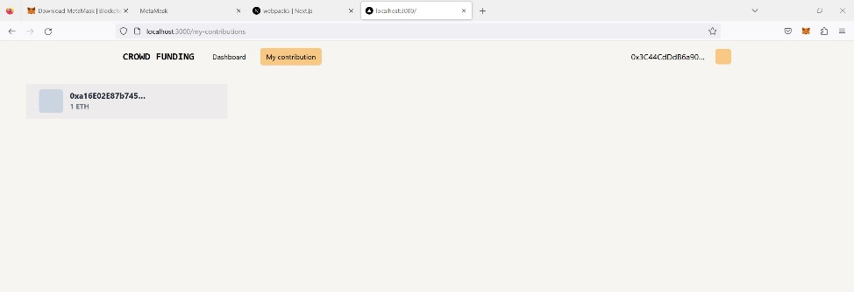
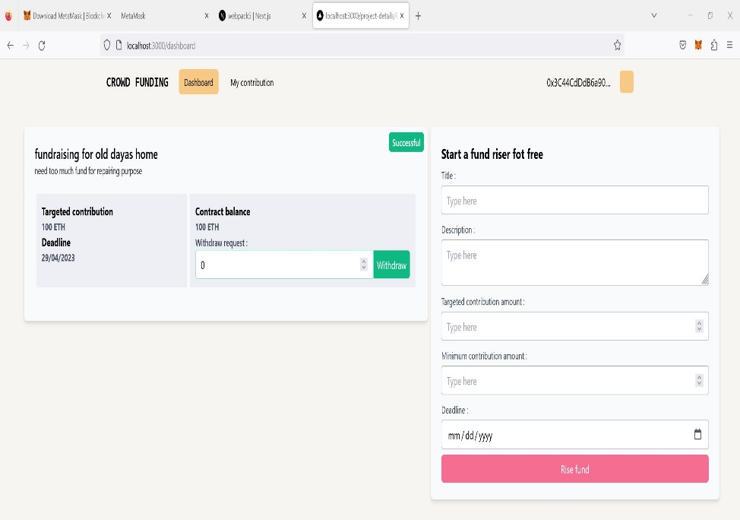
RESULT

Slide 13

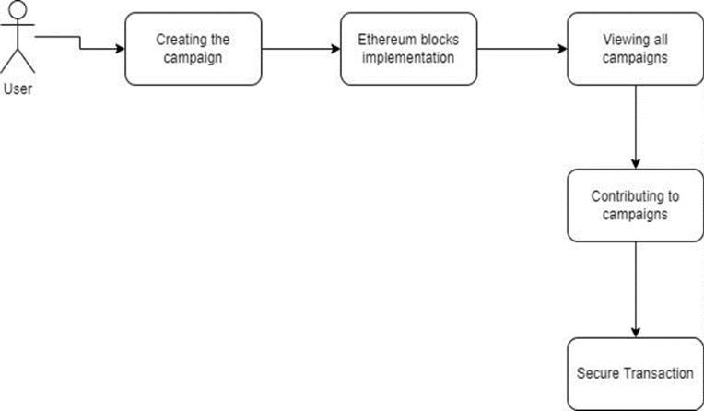
ARCHITECTURE DIAGRAM

Slide 14
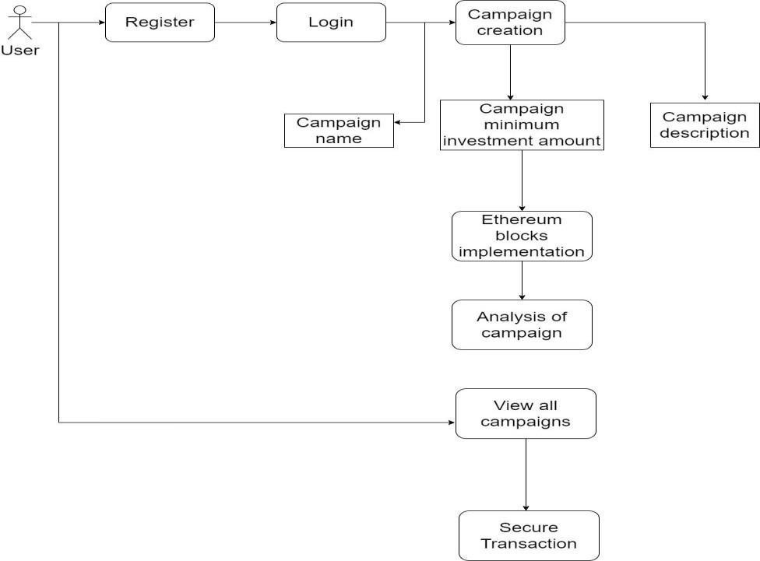
ARCHITECTURE DIAGRAM

Slide 15
RESULTS
A fundraising and charity platform aims to achieve greater accuracy and transparency in its operations. By implementing robust features, the platform ensures:
1. Detailed Information: The platform provides comprehensive campaign details, including information about the cause, the organization behind it, and how funds will be utilized. This enables donors to make well-informed decisions aligned with their values and interests.
2. Secure and Streamlined Donations: The platform incorporates secure online donation mechanisms, offering various payment options and advanced encryption technologies. This ensures that donations reach the intended recipients securely and efficiently.
3. Real-time Tracking: Fundraising campaigns on the platform are equipped with real-time tracking tools. Donors can monitor the impact of their contributions, track fund utilization, view progress updates, and receive reports on achieved outcomes. This fosters trust and confidence by showcasing the tangible difference made by their contributions.
4. Direct Communication: The platform facilitates direct communication channels between campaign creators and donors. This enables donors to engage meaningfully with the causes they support, ask questions, and seek clarifications.

Slide 16
CONCLUSION
In conclusion, crowdfunding has emerged as a popular and effective method for raising funds for various projects, causes, and initiatives. It allows individuals, businesses, and organizations to connect with a large pool of potential backers and supporters through online platforms. Crowdfunding has democratized the process of fundraising, making
it more accessible and inclusive for everyone.
Crowdfunding offers several benefits, including providing access to capital, market validation, and customer engagement. However, it also comes with its own set of challenges, such as the need for effective marketing, managing backer expectations, and delivering on promises made.
To succeed in crowdfunding, it is important to have a well-thought-out plan that includes a clear project description, realistic funding goal, and a comprehensive marketing strategy. Additionally, building a strong community of backers and supporters can help increase the chances of success.
Overall, crowdfunding has revolutionized the way people think about fundraising, and it will likely continue to play an important role in financing projects, businesses, and social causes in the future.

Slide 17
FUTURE ENHANCEMENT
Future enhancements for crowdfunding platforms could include:
1. Improved AI and machine learning: Advancements in AI and machine learning could be leveraged to better match creators with potential backers, increasing campaign success rates and facilitating easier support for creators.
2. More flexible funding options: Introducing flexible funding models where creators can keep the funds raised, even if they don't meet their goal, could make it easier for creators to secure funding and reduce risk for backers.
3. Integrated payment systems: Streamlining the payment process by integrating secure payment systems within crowdfunding platforms would enhance convenience and security, reducing the need for third-party payment systems.
4. Enhanced data analytics: Utilizing data analytics to provide creators with insights on campaign optimization, such as identifying effective marketing channels, ideal campaign launch times, and appealing reward structures, could improve their chances of success.
5. Support for international campaigns: Expanding crowdfunding support beyond North America and Europe to include other regions would facilitate a more global and inclusive crowdfunding landscape.
These enhancements would enhance the crowdfunding experience for both creators and backers, making it more efficient, accessible, and successful.

Slide 18
REFERENCES
[1] In the IEEE 4th International Conference on Computing, Power, and Communication Technologies (GUCON) held in 2021,
Darshan M, S.R Raswanth, Sundeep V V S Akella, and Priyanka Kumar presented a paper titled "A Secured Distributed Ledger
Based Fundraising Framework Using Smart Contracts.“
[2] In their paper titled "Developing a Reliable Service System of Charity Donation During the Covid-19 Outbreak, " Hanyang Wu
and Xianchen Zhu discussed the topic in IEEE Access, Volume 8, in 2020.
[3] Jiafeng Li, Fuyang Qu, Xin Tu, Tingfei Fu, Jiayan Guo, Jianming Zhu, “Public Philanthropy Logistics Platform Based on
Blockchain Technology for Social Welfare Maximization”, The 8th edition of the International Conference on Logistics,
Informatics, and Service Sciences (LISS) took place in 2018.
[4] Hadi Saleh, Sergey Avdoshin, Azamat Dzhonov, “Platform for Tracking Donations of Charitable Foundations Based on Blockchain T
echnology”, Actual Problems of Systems and Software Engineering (APSSE), 2019
[5]

Slide 19
REFERENCES
[5] Xin Fan, “Charity Supervision Management System Based on Blockchain”, 2nd International Conference on
Computer Science and Management Technology (ICCSMT), 2022
[6] Iqra Khalil, Omer Aziz, Numan Asif, “Blockchain and Its Implementation for Charitable Organizations”,
International Conference on Innovative Computing (ICIC), 2022
[7] Ahmed s. Musleh, Gang Yao, SM. Muyeen, “Blockchain Applications in Smart Grid–Review and
Frameworks”, IEEE Access (Volume: 7), 2019
[8] Gubaev Renat, Anton Peresichansky, Alexandr Belenov, Artem Barger, “Karma – blockchain-based charity foundation platform”, IEEE International Conference on Blockchain and Cryptocurrency (ICBC), 2021
[9] Emre Ertürk, Murat Doğan, Ümit Kadiroğlu, Enis Karaarslan, “NFT based Fundraising System for Preserving Cultural Heritage: Heirloom”, 6th International Conference on Computer Science and Engineering (UBMK), 2021
[10] Yaqi Zhou, “Understanding Users’ Reaction to Blockchain Technology on the Online Fundraising Platform
: —̾ Evidence from Scenario Simulation Experiments”, Conference on Computer Information Science and Artificial Intelligence (CICSAA) on a global scale. 2022

Slide 20
THANK YOU

